Slide 1

Malware scanner using yara framework
MINI PROJECT BATCH-9
GUIDE : MR J.NAGARAJU
TEAM MEMBERS:
1.K.SAMBA SHIVA RAO-22R21A6286
2.A.RAJESH-22R21A6267
3.Y.SHIVA KUMAR-22R21A62C6
4.K.VINEETH-22R21A6293

Slide 2
CONTENTS
Abstract
Problem statement
Existing system
Proposed system
Assets
Drawbacks
Requirements
Literature survey
Conclusion
References

Slide 3
ABSTRACT
Our YARA-based malware scanner provides an advanced solution for detecting malicious files using YARA rules. By integrating a comprehensive and constantly updated database of malware signatures, our tool ensures fast, accurate, and reliable detection of a wide range of malware threats.

Slide 4
Problem statement
The growing complexity and volume of malware pose significant challenges for traditional antivirus solutions. Many current systems struggle to keep up with new threats, leading to undetected infections and compromised systems.

Slide 5
EXISTING SYSTEM
Traditional antivirus programs often rely on outdated signature-based detection methods, heuristic analysis, and behavioral monitoring. These approaches can be slow, resource-intensive, and prone to false positives and negatives, failing to address the ever-evolving landscape of malware threats effectively.

Slide 6
PROPOSED SYSTEM
Our YARA-based malware scanner offers a more efficient and precise method for detecting malware. Utilizing YARA rules, the scanner can identify and classify malware based on specific patterns and characteristics within files. The system is designed to:
Leverage a comprehensive YARA signature database: Ensuring up-to-date detection of known and emerging threats.
Provide fast and accurate scans: Minimizing system resource usage while maintaining high detection rates.
Offer user-friendly interfaces: Simplifying the scanning process for both technical and non-technical users.

Slide 7
Assets
High-performance scanning engine: Optimized for speed and accuracy.
Extensive YARA rule database: Continuously updated to include the latest
malware signatures.
User-friendly interface: Designed for ease of use, even for non-technical users.
Detailed scan reports: Providing comprehensive information on detected threats.

Slide 8
Drawbacks
Dependence on YARA rules: Requires regular updates to the YARA rule database to maintain effectiveness.
Potential for false positives: Like any signature-based system, there is a risk of false positives, which can lead to unnecessary alarms.
Limited behavioral analysis: While highly effective at pattern matching, the system does not include behavioral analysis .

Slide 9
CHALLENGES
Maintaining an Up-to-date YARA Rule Database : Ensuring the YARA rule database is continuously updated with the latest malware signatures.
Scalability : Designing the system to handle a large volume of scans simultaneously.
Technical Support and Maintenance : Providing robust technical support to address user issues and queries.

Slide 10
Requirements
SOFTWARE AND HARDWARE :
Programming languages :HTML , CSS , JS , PYTHON and Yara-Python.
Frame works : Yara framework , flask framework.
Development Environment – IDE’s : VS code.

Slide 11
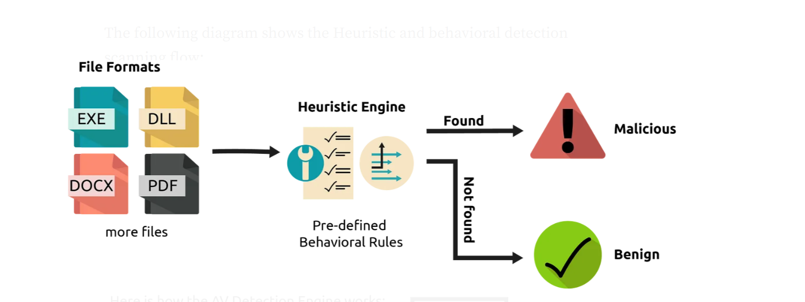
DESIGN ARCHITECTURE

Slide 12
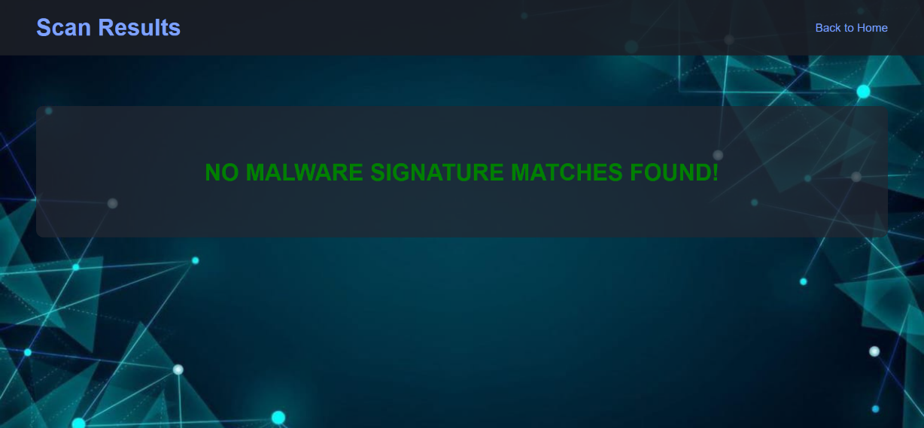
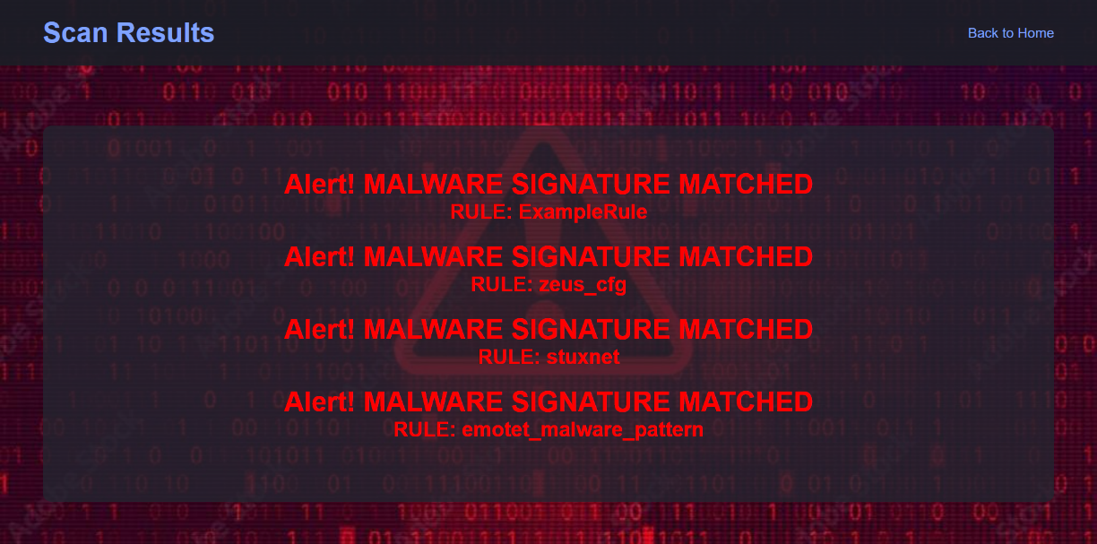
OUTPUT

Slide 13
Conclusion
The YARA-based malware scanner offers a powerful and efficient solution for detecting malware using advanced signature patterns. By addressing the limitations of traditional antivirus systems, our scanner provides enhanced protection against a wide range of threats, ensuring the security and integrity of users' systems.

Slide 14
Literature Survey
Studies show that YARA's pattern-matching capabilities significantly enhance the detection of both known and emerging threats. Relevant literature includes:
"YARA: The pattern matching swiss knife for malware researchers" by Victor M. Alvarez.
"Signature-Based Malware Detection" from the International Journal of Computer Applications.
"Comparative Analysis of Traditional and Modern Malware Detection Techniques" in the Journal of Information Security.

Slide 15
References
Alvarez, Victor M. "YARA: The pattern matching swiss knife for malware researchers." Available at: https://yara.readthedocs.io/en/latest/
"Signature-Based Malware Detection." International Journal of Computer Applications.
"Comparative Analysis of Traditional and Modern Malware Detection Techniques." Journal of Information Security.

Slide 16
THANK YOU

